Slide 1
Juvenile Delinquency
Name
Institution
Date

Slide 2
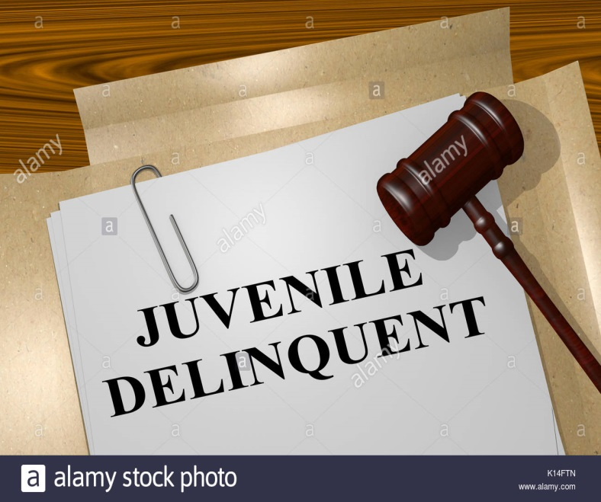
Introduction
Juvenile delinquency involves illegal actions committed by juniors.
It may include;
Minor violations such as skipping school
More risky crimes, such as violence and burglary (Delcea et al., 2019).
Notes:
Juvenile delinquency is a legal concept used to refer to all the illegal actions committed by juveniles (Delcea et al., 2019). It may include minor violations, such as skipping school to more risky crimes, such as violence and burglary. Having an apprehension of the forces that drive a juvenile to commit crime is essential in the prevention of future crimes. If juvenile delinquency is not addressed, the involved children grow into criminal adults, and this threatens families, communities, and nations. In light of juvenile delinquency, this assignment addresses the contributing factors, its effects, prevention interventions, and provisions of the Juvenile Act of 2015.

Slide 3
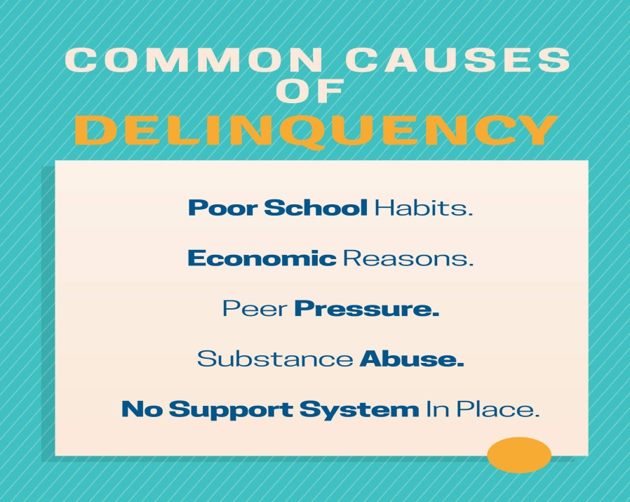
Contributing Factors
Domestic violence
Substance abuse
Poor socioeconomic status
Peer pressure (Anjaswarni et al., 2019).
Notes:
Some of the major contributing factors to juvenile delinquency include domestic violence, substance abuse, poor socioeconomic status, and peer pressure. Domestic violence, especially by parents, makes children turn violent as they tend to develop the attitude of a “don’t care” (Schepers, 2017). Notably, children involved in domestic violence or those who witness it become violent and aggressive, and a as result, it becomes easy for them to get into troubles. Children’s exposure to substance abuse compels them to engage in criminal activities for them to sustain their behavior of abusing drugs. Also, if children become addicted to drugs, they have to commit criminal activities to have money to purchase drugs. In addition, poor socioeconomic status forces children to engage in criminal activities to meet their needs (Anjaswarni et al., 2019). Conversely, criminal activities such as theft among children may be fueled by necessity rather than just the intention to commit crime. Besides, peer pressure from delinquent friends may force juveniles to commit criminal activities. Notably, if a child surrounds themselves with children who engage in delinquent activities, they feel more pressured to engage in such activities to gain acceptance in their friendship circles.

Slide 4

Effects of Juvenile Delinquency
Fuels criminal activities
Creates family instability
Increases health risk
Juveniles lose their freedom (Sharkey et al., 2017).
Notes:
Juvenile delinquency fuels criminal activities, creates family instability, causes health risks, and makes juveniles lose their freedom. Notably, juvenile delinquency fuels criminal activities like drug trafficking and burglary as children seek alternative means of survival (Sharkey et al., 2017). These activities threaten societal security as the number of criminal activities and criminal groups increase at society level. Also, juvenile delinquency creates instability in families as family members struggle with the trauma of a delinquent family member (Newbury et al., 2018). Raising legal fees and satisfying the needs of the delinquent juvenile also make families unstable. In order to manage psychological issues, family members may be forced to enroll in counseling services, which may end up being too costly for families. Besides, when delinquent juveniles are put under probation or incarceration, they lose their freedom. For example, when juveniles are incarcerated or probated, they may miss academic activities, and this negatively affects their academic welfare. Juvenile delinquency is also a health hazard to juveniles. Notably, juveniles involved in juvenile delinquency engage in health risk behaviors like risky sexual behaviors and drug abuse. Drug abuse may increase the risk of chronic health conditions like liver cirrhosis. Risky sexual behaviors also increase the risk of contracting sexually transmitted diseases like HIV/AIDS. Consequently, the quality of life for the involved juveniles deteriorates.

Slide 5
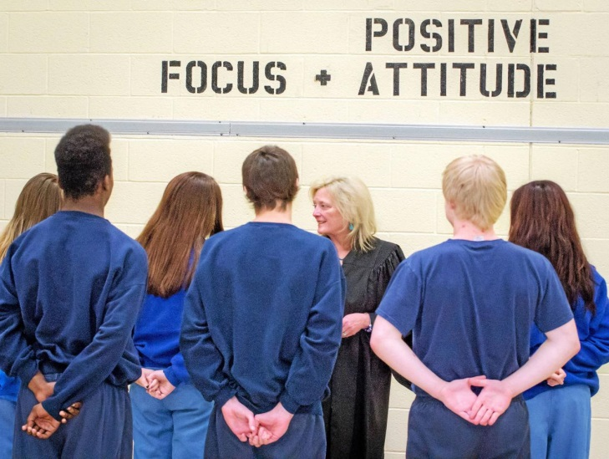
Prevention Interventions
Rehabilitation of previously convicted juveniles
School counseling
Effective policing
Parents should monitor their children closely (Crowl, 2017).
Notes:
Some of the interventions to prevent juvenile delinquency include rehabilitation, school counseling, and effective policing. Notably, previously convicted juveniles should be properly rehabilitated before being released back into society to avoid re-offending (Weisburd et al., 2017). Social workers specialized in crime prevention should meet with previously convicted juveniles and engage them on how they can avoid future crimes. For example, for the juveniles addicted to drug abuse, social workers may offer rehabilitation services to help them from abusing drugs. Learning institutions are also better placed to help in solving and preventing juvenile delinquency. Conversely, schools should identify learners who face domestic violence and offer counseling services to them. This implies that schools need to have an understanding of the family backgrounds of their learners. Moreover, effective policing may be beneficial in combating the recruitment of juveniles into criminal activities (Crowl, 2017). If the police become effective in their policing, they are likely to combat criminal groups at he community level. As a result, juveniles will have low chances of being recruited in such groups. Parents can also be effective stakeholders in preventing juvenile delinquency. Notably, parents should keenly monitor the behavior patterns and companies of their children. Parents should make sure that their children are productive in social and community activities.

Slide 6
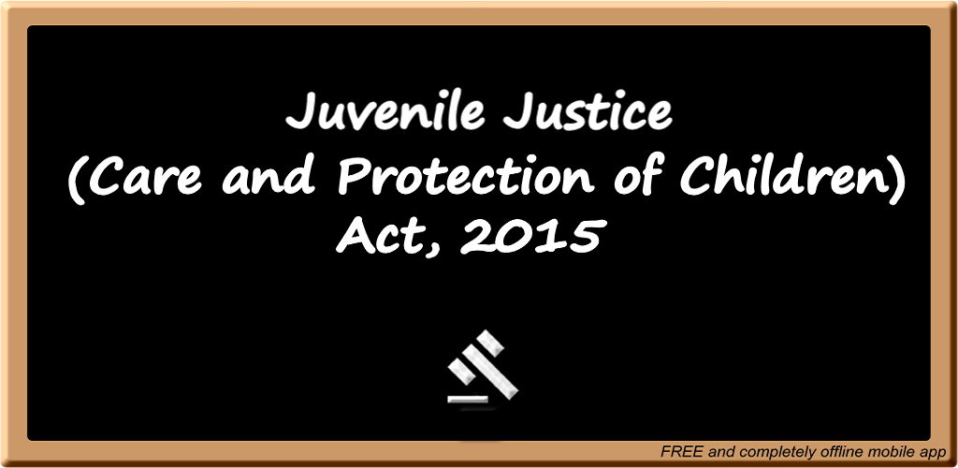
Provisions of Juvenile Act 2015
Inclusion of new definitions like heinous crimes
Change the word juvenile to child
Establish Juvenile Justice Boards
Inclusion of new offences perpetrated against children (Agarwal, 2018).
Notes:
The Juvenile Act of 2015 was implemented to help in meeting the goals of the United Nations Convention on the Rights of Children (Agarwal, 2018). One of the provisions of this act is the inclusion of new definitions like heinous and petty crimes perpetrated by juveniles and abandoned children (Babar, 2018). Another provision is nomenclature change across the act, especially from juvenile to child, to eliminate the negative implications linked with the term juvenile. Notably, juvenile is a word that is used to describe physically or emotionally immature persons. Additionally, the act provided for the establishment of Juvenile Justice Boards in all districts (Sudha & Neya, 2019). These boards constitutes of a principal magistrate and two social workers, one of whom has to be a lady. The mandate of the boards include deciding on juvenile cases that conflict with the law, liaise with Child Welfare Committee to attend to needs of children, and liaise with other district boards to ensure due process is followed in disposing cases. Moreover, the act sought to include new offences perpetrated against children, These offences include child abduction, children procurement, and militia’s use of children.

Slide 7

Conclusion
Juvenile delinquency refers to all illegal actions committed by minors.
Causes include domestic violence and substance abuse
Solutions include rehabilitation of previously convicted juveniles and effective policing.
Notes:
Juvenile delinquency refers to all the illegal actions committed by minors. Some of the causes of juvenile delinquency include domestic violence, substance abuse, peer pressure, and poor socioeconomic status. Juvenile delinquency can be prevented or solved through interventions like rehabilitation of previously convicted juveniles, school counseling, and effective policing. Juvenile delinquency should be prevented and managed because it fuels criminal activities, creates family instability, causes health risks, and makes juveniles lose their freedom.

Slide 8
References
Agarwal, D. (2018). Juvenile delinquency in India—Latest trends and entailing amendments in Juvenile Justice Act. People: International Journal of Social Sciences, 3(3), 1365-1383.
Anjaswarni, T., Nursalam, N., Widati, S., & Yusuf, A. (2019). Analysis of the Risk Factors Related to the Occurrence of Juvenile Delinquency Behavior. Jurnal Ners, 14(2).
Babar, A. V. (2018). The law for juvenile injustice: Critical analysis of the Juvenile Justice (Care and Protection) Act, 2015. Journal of Legal Studies and Research, 4(2).
Crowl, J. N. (2017). The effect of community policing on fear and crime reduction, police legitimacy and job satisfaction: an empirical review of the evidence. Police Practice and Research, 18(5), 449-462.
Delcea, C., Fabian, A. M., Radu, C. C., & Dumbravă, D. P. (2019). Juvenile delinquency within the forensic context. Rom J Leg Med27 (4), 366-372.
Newbury, J., Arseneault, L., Caspi, A., Moffitt, T. E., Odgers, C. L., & Fisher, H. L. (2018). Cumulative effects of neighborhood social adversity and personal crime victimization on adolescent psychotic experiences. Schizophrenia bulletin, 44(2), 348-358.

Slide 9
References
Schepers, D. (2017). Causes of the causes of juvenile delinquency: Social disadvantages in the context of Situational Action Theory. European journal of criminology, 14(2), 143-159.
Sharkey, P., Torrats-Espinosa, G., & Takyar, D. (2017). Community and the crime decline: The causal effect of local nonprofits on violent crime. American Sociological Review, 82(6), 1214-1240.
Sudha, R., & Neya, A. S. (2019). Juvenile Justice Act (JJ ACT), 2015. TNNMC Journal of Pediatric Nursing, 7(2), 34-35.
Van der Put, C. E., Boekhout van Solinge, N. F., Stams, G. J., Hoeve, M., & Assink, M. (2020). Effects of awareness programs on juvenile delinquency: a three-level meta-analysis. International journal of offender therapy and comparative criminology, 0306624X20909239.
Weisburd, D., Farrington, D. P., & Gill, C. (2017). What works in crime prevention and rehabilitation: An assessment of systematic reviews. Criminology & Public Policy, 16(2), 415-449.

